Slide 1
Test Automation Role Based Training for SQAE

Slide 2
Contents
Test automation (30 minutes)
Automation philosophy
What to automate and what not
Commonly used financial terms in test automation (1 hour)
ROI, Payback period, Break-even point, Fixed cost and Variable cost
Virtusa’s test automation assessment framework (1hour)
Automation needs assessment
Automation readiness assessment
Essentials of test automation architecture (1hour)
Virtusa test automation framework (VTAF 2.0) (1hour)

Slide 3
Test Automation
What to automate and what not?

Slide 4
Overview
Objective of this session
Highlight factors that need to be considered before automation
Define approach to identify what can be automated and what cannot
Duration
30 minutes

Slide 5
Test automation is considered successful if it can reduce costs & test effort
Test Automation Philosophy
Test Automation aims at improving the ‘effectiveness’ and ‘efficiency’ of the test process through out the system life cycle
Test Automation helps in being able to test quickly and consistently
Test Automation is not a goal by itself, it is a value addition to manual testing
Test Automation demands a paradigm shift from ‘tool-orientation’ to ‘process orientation’
Test Automation is a long term investment
Automation isn’t always a good idea, and sometimes manual testing is better. The key is to know what the benefits and costs really are, then to make an informed decision about what is best for your circumstance.
Source:- Automated Testing Handbook by Linda G. Hayes
Notes:
Test Automation project to be successful, structured manual test process should be in place. Other wise, we will be automating Chaos, resulting in faster chaos. The minimum things that needs to be in place are : Shielded test environment which is a replica of the production environment, Test Cases With pre-conditions, Input and expected results. Test Environment’s database which can be re-stored to a known state, Necessary hardware to execute the tests, Technical personnel with Advanced programming skills in Test tool etc…

Slide 6
While complete test automation is a great thing to have, it is essential to acknowledge that not everything can / needs to be automated
What tests to automate?
Tests that need to be run for every build of the application (sanity level)
Tests that use multiple data values for the same actions (data driven tests)
Tests that require detailed information from application internals (e.g., SQL,GUI attributes)
Stress / load testing
What not to automate?
Usability testing
Usage models - how easy is the application to use
One time testing
“ASAP” testing
Need to test it NOW
Ad hoc / random testing
Based on intuition and knowledge of application
Tests without predictable results
The more tedious the execution of the test case, the better candidate it is for automation.
The more creativity needed for test case execution, the less appropriate it is for automation.

Slide 7
Commonly used financial terms in test automation
ROI, Payback period, Break-even point, Fixed and Variable cost

Slide 8
Overview
Objective of this session
Develop an awareness on the commonly used financial terms
Duration
1 hour

Slide 9
Developing a general awareness on some of the commonly used financial terms will help in measuring success of test automation
Breakeven Point
Expressed as duration or in money terms
Defines a point where the costs are exactly equal to the income
Projects with earlier breakeven point are preferred over projects with late break even points
Payback Period
Defines the minimum period (time or duration) required to recover the investment
Project with lower payback period are preferred over projects with higher payback period (other things remaining constant)
Fixed and Variable Costs
Fixed costs are fixed irrespective of work produced
License cost of tool
Variable costs varies with every single work produced
# of team members billing
Helpful in estimating the investment for test automation
ROI
Called “Return on Investment”
Compares the investment with costs and identifies the rate of return
Positive ROI indicates profit while negative ROI indicates loss

Slide 10
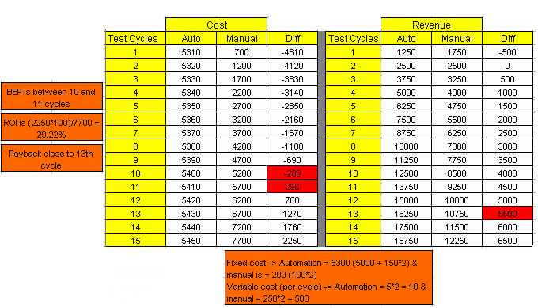
Any test automation effort is considered successful when the financial benefits outweigh the financial costs
Illustration: Assume the following variable for a test automation effort.
Total number of test cycles – 15
Cost of automation tool license - $5,000
Wage cost per hour - $ 2 & billing rate is $ 5 per hour
Time
Writing manual test cases – 100 hours & executing 1 cycle of manual test cases – 250 hours
Developing automation scripts – 150 hours & executing 1 cycle of automated test scripts – 5 hours

Slide 11
Virtusa’s automation assessment framework
Automation needs assessment
Automation readiness assessment

Slide 12
Overview
Objective of this session
Explain Virtusa’s automation assessment framework
Walkthrough artifacts that are part of the automation assessment framework
Duration
1 hour

Slide 13
Need for Assessment
Embarking on test automation without a systematic assessment can lead to inefficiencies which result in failed automation efforts
Assessing an organization’s current capabilities helps formulate effective automation test strategies
Understanding client’s awareness / previous experiences with test automation provides teams with valuable insights using which appropriate delivery models can be deduced
Identifying and setting up of means that measure success of test automation helps avoid expectation mismatch. Upfront automation assessment helps in defining those expectations

Slide 14
What To Assess?
A typical automation assessment could cover different aspects of the client’s operational environment. This includes:
Tools
Customer preferences
Licenses
Test environment
Familiarity with test automation
Current automation capabilities
Expectations from automation and measures of success
Automation scope definition
Schedules and timelines
Readiness to automate

Slide 15
When And How To Assess?
Automation assessment can be performed:
To sell our automation consultancy service offering
As part of pre-sales process for coming up with a RFP
As part of pre-inception or discovery phase to define a test strategy
Selective assessment focusing on specific aspects based on needs
Assessment can be done by conducting:
Personal interviews and workshops
Applying a structured assessment questionnaire

Slide 16
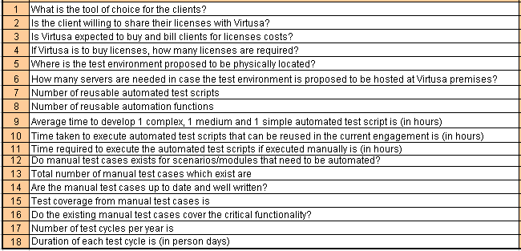
Assessment Summary
An effective automation assessment can provide answers to many questions such as:

Slide 17
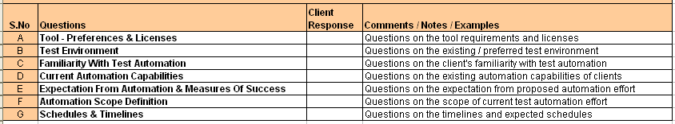
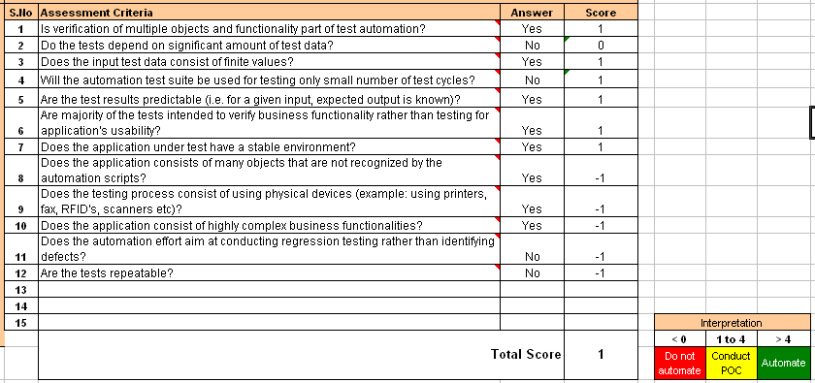
Assessment Templates
Test Automation Assessment
Test Automation Readiness Summary
Templates with sample data. For illustration

Slide 18
Essentials of test automation architecture
Need for test automation architecture
Key components of test automation architecture

Slide 19
Overview
Objective of this session
Provide insights in the fundamentals of automation architecture
Duration
1 hour

Slide 20
Key challenges for test automation are maintainability and reliability
BUSINESS DRIVERS FOR TEST AUTOMATION
These challenges demand that a software engineering approach be taken to address them
Same rigor and standards
Same application development philosophy
Good test automation results in businesses realize
Reduced test execution time
Reduced cost of test execution
Increase in ROI
Increased reusability of test assets across organization
Ensures scalability and minimization of rework
Consistent and repeatable test execution
Improved utilization of resources (people and machines)
Frees up test engineers time and helps them explore corner test conditions
Test Automation become a liability if maintainability and reliability are not considered

Slide 21
Traditional approach relies on Record and Playback approach towards test automation
TEST AUTOMATION – TRADITIONAL APPROACH - DRAWBACKS
Adhoc Project Inception
Gather requirements
Decide on automation tool
Identify team & train
Minimum planning
No defined quality criteria
Automation Approach
Predominantly Record and Playback
Minimum scripting
Develop from scratch approach
Regular maintenance
Disposable test scripts
People dependent
Limitations in traditional automation approach make test automation time consuming and expensive affair

Slide 22
Traditional approach fails in ensuring maintainability and reliability of test scripts
TEST AUTOMATION – TRADITIONAL APPROACH - DRAWBACKS
No Reusability
Across Modules
Across Products
Frequent script failures and high maintenance
No Parameterization resulting in hard coding
Non Scalable by design
No standards or guidelines
No Exception / Error handlers
Customization not possible
Schedule overrun due to rework
Negative ROI
Automation effort is unsuccessful and tools become shelfware
According to International Institute of Software Testing, 85% of all test automation initiatives are unsuccessful

Slide 23
Automation Architecture serves as a means of managing and communicating the fundamental characteristics and features of the automation software system
TEST AUTOMATION ARCHITECTURE
Architecture provides a governing focus for the test automation software that enables the required system to be realized in respect to key aspects such as:
Maintainability
Reliability
Reusability
Portability
Configurability
Usability
Discernability
Performance
Benefits from a well defined automation architecture
Reduces redundancy and increases reuse
Reduces time to develop automation suite
Robust and highly scalable
Requires minimum maintenance
Highly portable
Increases the ROI
Notes:
Maintainability
Maintainability is the ease with which a script can be corrected when an error is encountered, be adapted if the environment changes, or be enhanced if the requirements change.
Reliability
Reliability is the probability that the automation test suite will provide failure free operation with consistent test results in a stated condition (for instance, the frozen release of the AUT) for a fixed interval of time
Reusability
The scripts are designed to reuse existing code from other sections of the test suite. Reusable chunks of code would be identified while creating the test suite.
The reusable code can be classified into two categories.
Canonical components under the generic library.
Businesses components under the business library
Portability
The architecture would be designed in such a way that all test suite contents would be packaged in a single folder to allow implementation in any of the Test Director folders.
The folder structure is defined in a folder structure. Test scripts would be parameterized to avoid hard coding. All test scripts would be designed to adapt to any of the user input and dynamically identify headings and objects at runtime.
Configurability implies the ability of the Test automation suite to adapt to different test execution environments, browsers, and different execution sequences.
Usability is the ease with which the test script executor can perform the following:
Install the automated test suite.
Understand the overview of the test suite,
Execute the test scripts.
Interpret the test execution results.
Discernability is the distinctness that makes perception easy. This can be achieved by using the following techniques:
Indent Blocks of Code
Use With and End With Statement etc

Slide 24
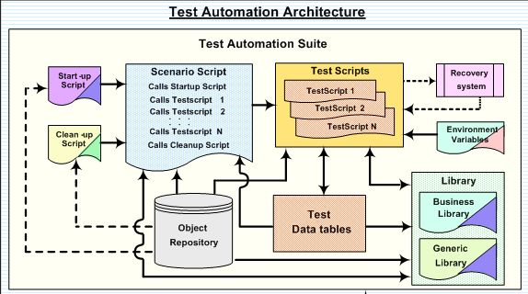
While automation architecture is product and situation dependent, any architecture model displays common attributes
KEY COMPONENTS OF AN AUTOMATION ARCHITECTURE
Test
Scripts
Recovery
System
Environment
Variables
Object
Repository
Libraries
Data Tables
Notes:
1) Test Scripts → Test scripts would take test data from data tables. The test scripts would reuse components from reusable actions, business and generic libraries. These test scripts would take application GUI (objects) information from the Object Repository
2) Object Repository → Object repository is an interface between the test scripts and the application objects. It consists of all the AUT’s objects with their logical names and physical properties.
3) Data Tables → The test data would be maintained in Excel (or any other data storage mechanism) data tables and organized by functional topics. The architecture would use the ‘data driven approach’ and ‘keyword driven approach’ to retrieve test data required by the test scripts.
4) Recovery system is used to recover the automation suite from major errors in the AUT (show stoppers), or minor failures (ex: login failures), or any unexpected errors (ex: browser pop-up’s) at runtime. These errors make it almost impossible to continue with the test execution. In such situations, the recovery mechanism will stop or recover from the failures or recover from the unexpected events.
5) All Environment Variables are stored in an XML file (or any other similar format). This file is used to define application URL, minimum wait time, maximum wait time, location of the screen shots and location of the customized Test Report Files.
6) Libraries would help avoid code duplication across the test suite and promote code reuse. Library is logically divided into Generic and Business. Generic Library: Generic library incorporates canonical functions and procedures of the framework that would be reused by all the test scripts in the architecture. These generic functions can contact the object repository, test scripts and script driver.
Example: fgCloseAllbrowsers() is used before or after executing the test script.
Business Library: Business library pertains to functions and procedures related to business tasks/functions of the application. These business functions also contact the Object Repository, Test Scripts and Script Driver.
Example: fbTableValidator () is used to validate the contents of the table in the business logic.

Slide 25
Questions ?

